Slide 1

Web Programming with The Laravel Framework: Authorization
Summer semester 2022
Steven Lolong
Paul Fallscheer-Schlegel

Slide 2
Authentication vs Authorization
Authentication: Verifying who a user is
Authorization: Verifying what a user has access to
Airport example:
Show your ID = authenticate your identity
Present your boarding pass = authorizes you to board and allow access to the plane
Authorization web example: admin vs user

Slide 3
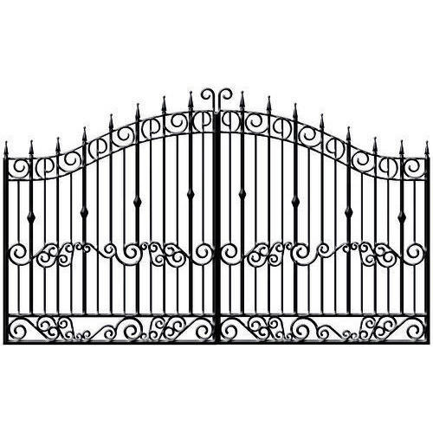

Authorization in Laravel: Gates and Policies

Slide 4
Authorization in Laravel: Gates and Policies
Laravel comes with build in Auth service provider
register gates/policies in Providers/AuthServiceProviders.php
gates are like routes, policies like controllers

Slide 5
Gates
Closure-based approach
Defines what actions a specific user is allowed to do
Good for easy frontend seperation: For example display buttons only for admin with @can/@endcan in blade with setup roles in
Example:
in AuthServiceProvider.php: Gate::define(ability: ‚tasks_create‘, fn(User $user) => $user->is_admin);
In data.blade.php @can(‚tasks_create‘) … @endcan

Slide 6
Gates: Example
Only Blog post owner is allowed to preview post

Slide 7
Gates: Example
Define our gate in the ‚boot‘ method of AuthServiceProviders.php: Gate::define(‘view-post‘, function(User $user, Post $post){ return $user->id === $post -> user_id;
})
return is bool (true/false)

Slide 8
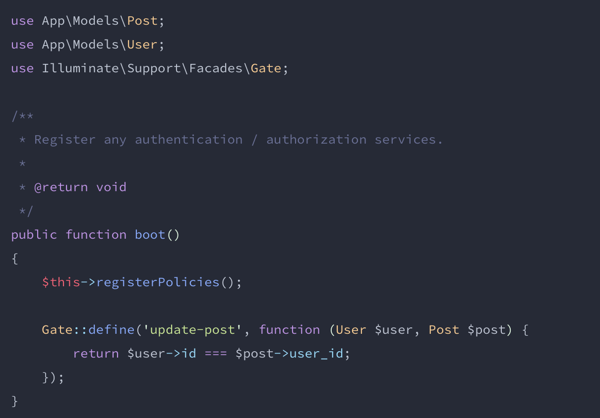
Gates: Example

Slide 9
Gates: Example
Now set up the route you want to have authorized with: if(\Illuminate\Support\Facades\Gate::denies(‚view-post‘, $post)){ abort(403) }
NB: You can also use Gate::allows or the Gate::authorize method

Slide 10
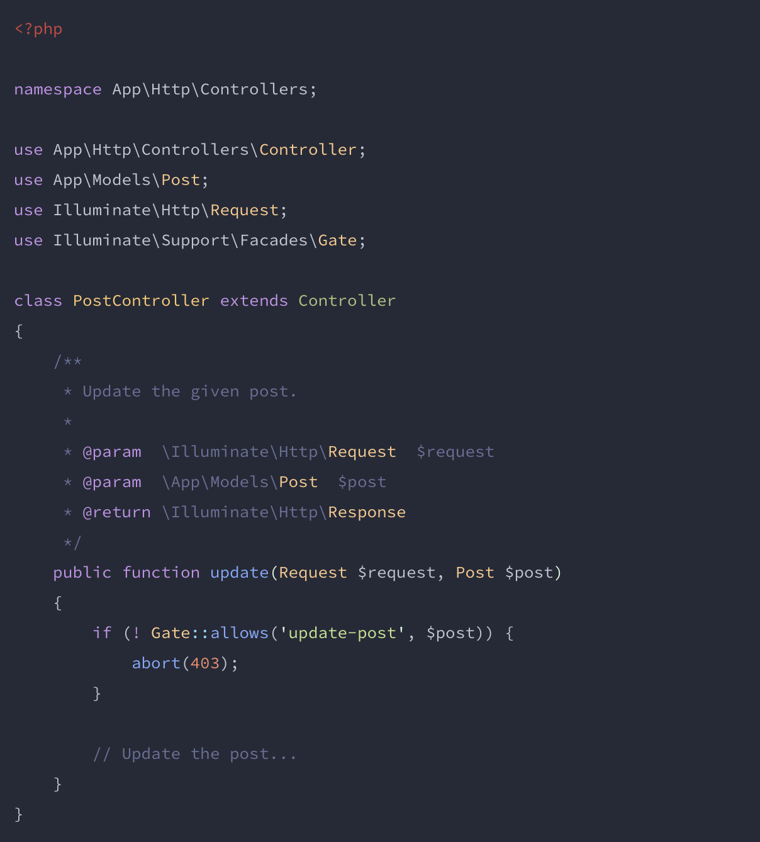

Slide 11
Gates: Conclusion
Positiv: quick and dirty for small applications
Negative: defining all gates inside the service provider can become messy

Slide 12
Policies
Wrap up logic arround a certain resource in specific class
Grouping permissions by model
Laravel automaticly discovers policies as long as model name and policy name follow naming conventions

Slide 13
Policies: Example
Only Blog post owner is allowed to preview post

Slide 14
Policies: Example
Create new policy with “>php artisan make:policy PostPolicy“ and add public function view(User $user, Post $post){ return $user ->id == $post->user_id; }
return is bool (true/false)

Slide 15
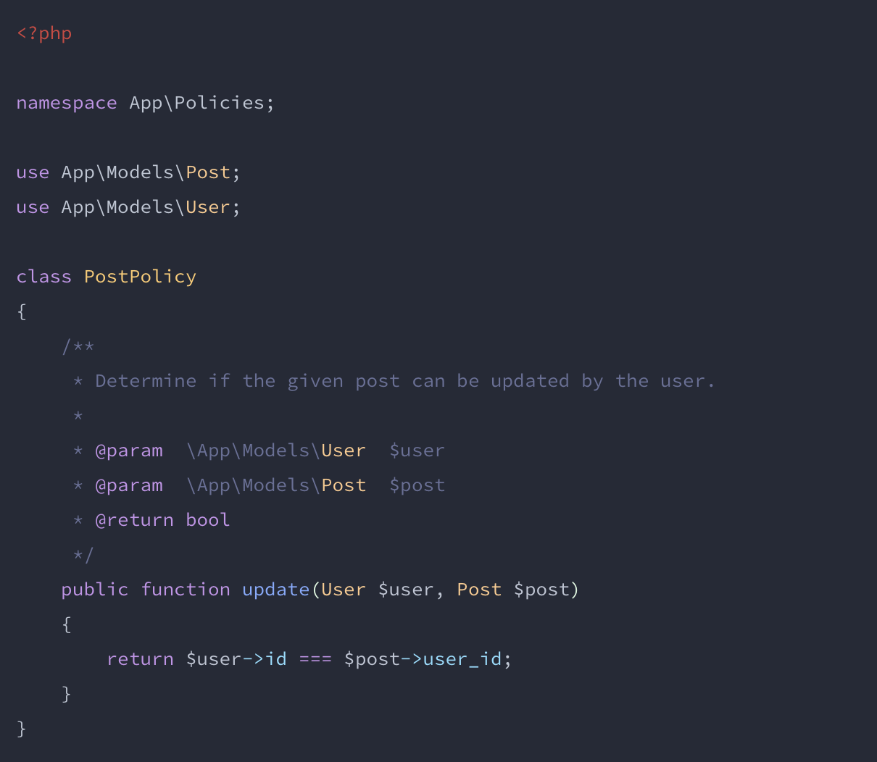

Slide 16
Policies: Example
Now set up the route you want to have authorized with: (\Illuminate\Support\Facades\Gate::authorize(‚view‘, $post)){ abort(403) }
NB: You can also use Gate::allows or the Gate::denies method

Slide 17
Policies: Conclusion
Positive: automaticly discovers policies, well structured
Negative: a little more tricky to setup

Slide 18
Finally
Most applications mix gates and policies
Gates are most applicable to actions that are not related to any model or resource, (for example admin dashboard)
policies should be used to authorize an action for a particular model or resource

Slide 19
Thank you!
Questions?

